Slide 1
Dissemination Techniques of Maps

Slide 2
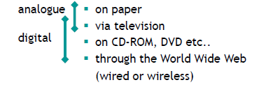
How do we disseminate maps to users?

Slide 3
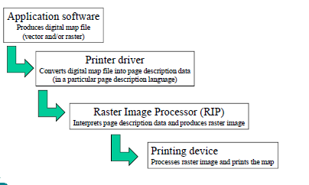
Analogue dissemination: printing a digital map
Notes:
A page description language (PDL) is a language that describes the appearance of a printed page in a higher level than an actual output bitmap. An overlapping term is printer control language, which includes Hewlett-Packard's PCL. PostScript is one of the most noted page description languages.
Data sent to a printer must be in a language that the printer can understand. These languages are called Page Description Languages, or PDLs.

Slide 4
Analogue dissemination: on paper
Printers
e.g. ink-jet, laser, thermal-wax transfer, dye-sublimation
only for relatively few copies (<20)
Photocopying
problems with quality and price
Offset printing
for a large number of copies, still widely used

Slide 5
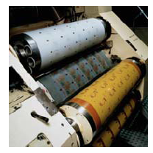
Analogue dissemination: offset printing
Reproduction method in which lithographic plates containing the map image are placed on drums
Often 4 colour process
printing (CMYK)
Send digital files resulting from graphics s/w to service bureau, which produces colour separates with image setter
Notes:
Intaglio (/ɪnˈtæli.oʊ/ in-TAL-ee-oh) is the family of printing and printmaking techniques in which the image is incised into a surface, and the incised line or sunken area holds the ink. It is the direct opposite of a relief print.
Relief printing is a process where protruding surface faces of the printing plate or block are inked; recessed areas are ink free. Printing the image is therefore a relatively simple matter of inking the face of the matrix and bringing it in firm contact with the paper.
Lithography (from Ancient Greek λίθος, lithos, meaning "stone", and γράφειν, graphein, meaning "to write") is a method of printing originally based on the immiscibility of oil and water. The printing is from a stone (lithographiclimestone) or a metal plate with a smooth surface.

Slide 6
Analogue dissemination: paper maps
Advantages:
Good graphical quality / high resolution
High information density / level of detail
Large formats possible / overview
No need of equipment (e.g. PC or PDA)
Disadvantages:
Static
Fixed scale
Physical boundaries to area portrayed
No adjustment to individual demands

Slide 7
Digital dissemination: Map displays on monitor screens
Advantages:
Interaction: adjustable to individual needs
Links to additional info (multi-media)
Panning and zooming
Seamless
Possibly dynamic (animations)
Disadvantages:
Low screen and colour resolution
Output conditions vary
Limited display size / overview
Equipment required / portability

Slide 8
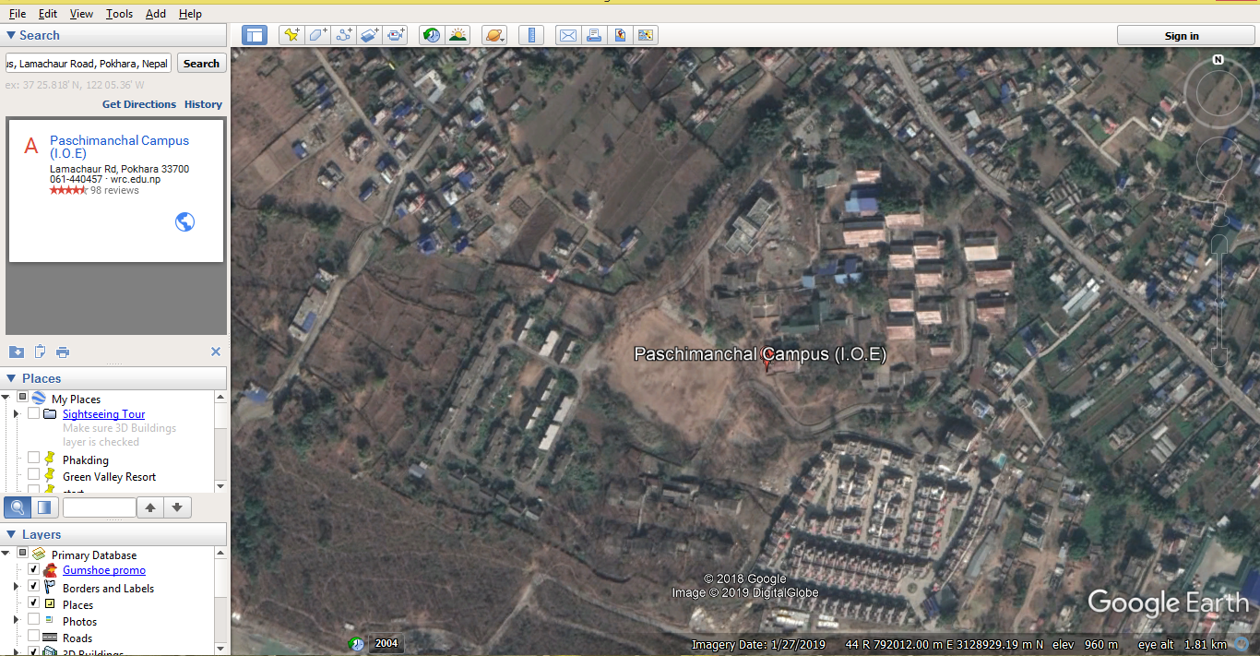
What’s the use of Web maps?
compared to e.g. CD-ROM
accessibility
actuality
For example: Google Earth (accessibility of remote sensing imagery)

Slide 9
Web dissemination
World Wide Web = major medium for the
dissemination of maps to their users (millions
of maps a day)

Slide 10
Diverging Web user profiles
all levels of education
common in every home and business
all levels of income (but the lowest)
more women online than men
8-16 years age group coming up
seniors fastest-growing group of users
world-wide number of Internet users still growing exponentially (1600 million in 2008
= 24% of World population)

Slide 11
Problems / limitations web maps
Access
Internet access
accessibility for everyone?
Medium
problems related to computer (see disadvantages map displays on monitor screens)
no control over final appearance
speed of data transfer
Content
finding web maps and geodata
language
actuality
Web maps / geodata: free or for fee

